Slide 1
TELEPHONE ETIQUETTE

Slide 2
ANSWERING THE PHONE
Pickup the phone in three rings.
Greet the caller to show your respect.
Give your name.
Ask the customer if or how you can help

Slide 3
USAGE OF TONE AND LANGUAGE
Use your normal tone of voice when answering a call.
In case if you have a tendency to speak loud avoid doing it on the telephone.
Speak in a normal and effective manner.
Never use harsh words.
Words delivered should be clear & understood to the caller.

Slide 4
FORBIDDEN PHRASES
I don't know
I can't do that
I won't
No

Slide 5
DO'S
Be patient
Respond clearly when speaking
Always remember if speaking in behalf of someone please mention it to the caller.
Else note down the caller's number so that a concerned user can make a call back on the query.
Address properly by their title.
Always ask if you can put the caller on hold.

Slide 6
DON'TS
Do not eat or drink while speaking.
Do not use poor language.
Never address an unfamiliar caller by their name.
Never talk back or act rude.
Never leave the caller on hold for more than 20 second.

Slide 7
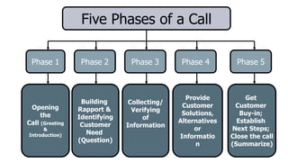
5 PHASES OF A CALL

Slide 8
THANK YOU

